Slide 1
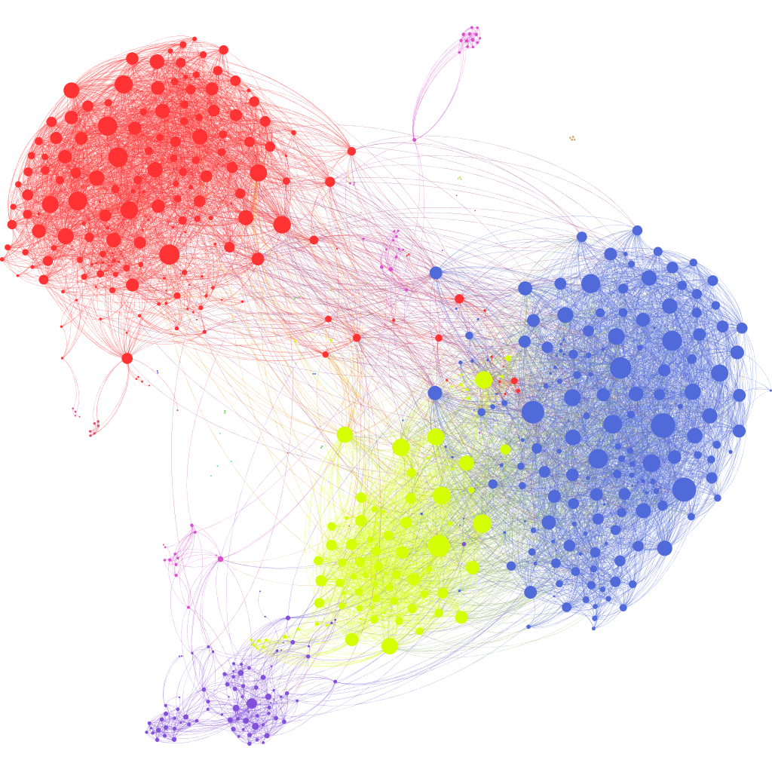
Intro to Computer Vision

Slide 2
Agenda
Math Primer: Convolution
What CNNs Can Do
Why CNNs
Convolutional Neural Network Basics
Convolutional Filters and Weight-Sharing
Basic CNN Architecture
Data Augmentation

Slide 3
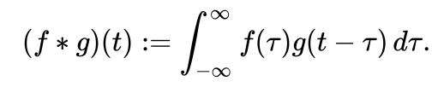
Convolution
Mathematical operation of two functions (f and g) that produces a third function f * g.
It is defined as the integral of the product of the two functions after one is reflected about the y-axis and shifted.
Graphically, it expresses how the ‘shape’ of one function is modified by the other.

Slide 4
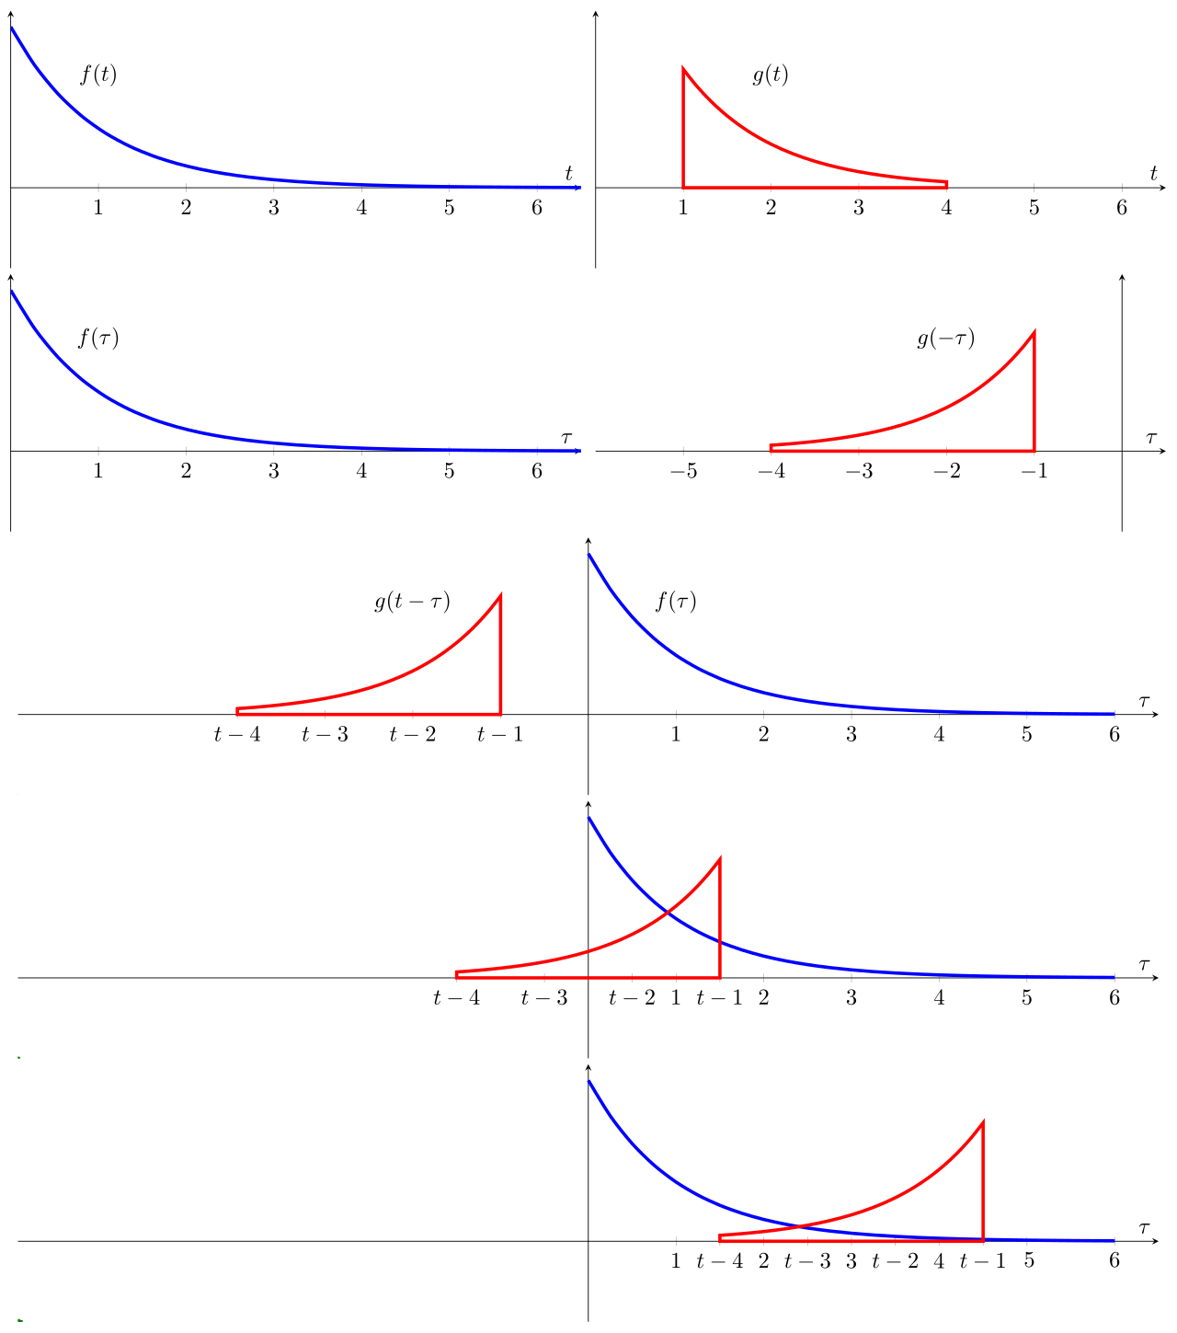

Convolution

Slide 5
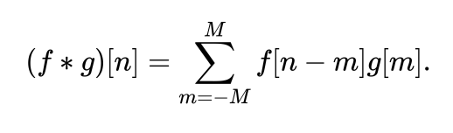
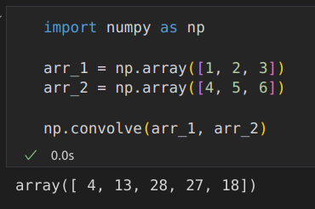
Discrete Convolution
[1, 2, 3]
[6, 5, 4] -> 4
[1, 2, 3]
[6, 5, 4] -> 13
[1, 2, 3]
[6, 5, 4] -> 28
[1, 2, 3]
[6, 5, 4] -> 27
[1, 2, 3]
[6, 5, 4] -> 18
Note how the convolution operator flips the second array before “sliding” the two across one another

Slide 6
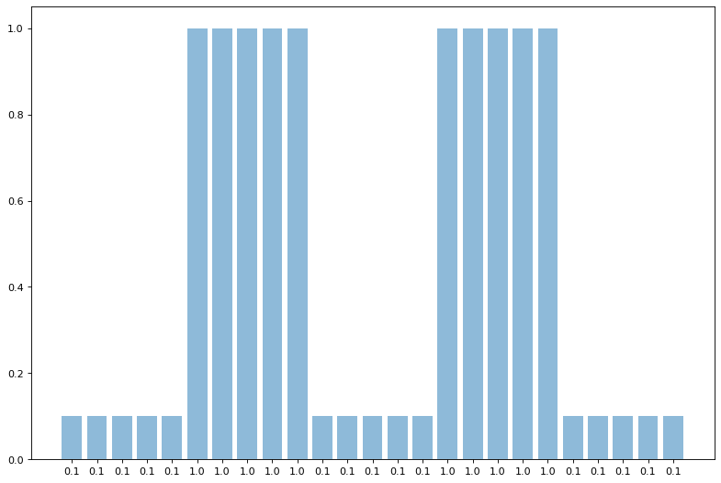
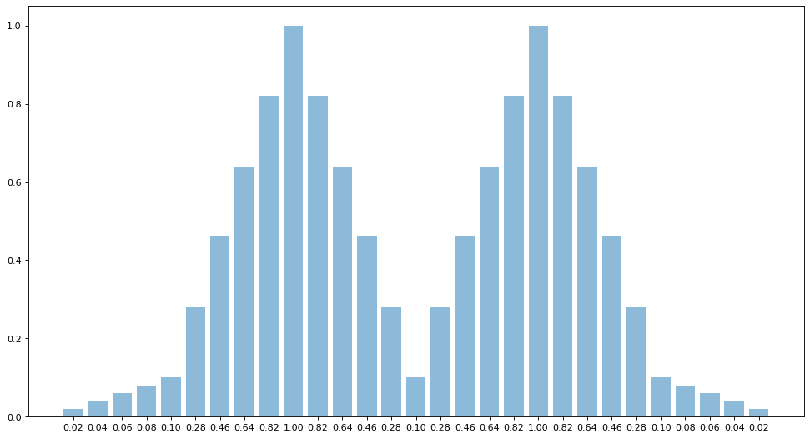
1D Discrete Convolution
[0.2, 0.2, 0.2, 0.2, 0.2]

Slide 7
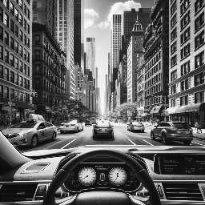

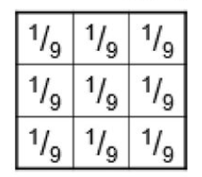
2D Discrete Convolution - uniform filter

Slide 8
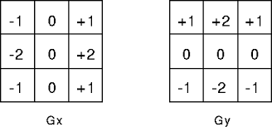
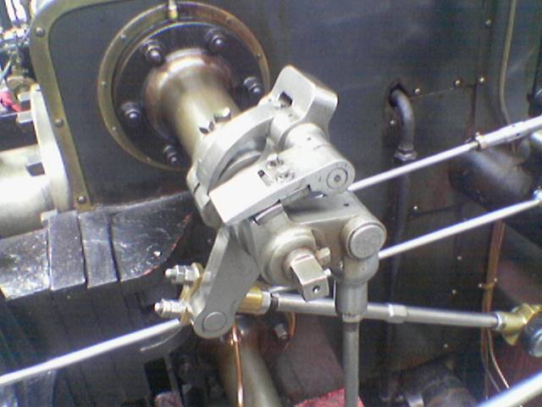
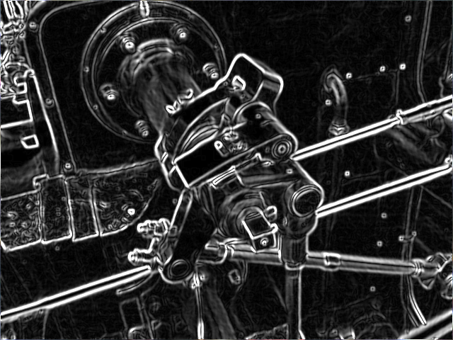
2D Discrete Convolution - Sobel operator
https://en.wikipedia.org/wiki/Sobel_operator

Slide 9
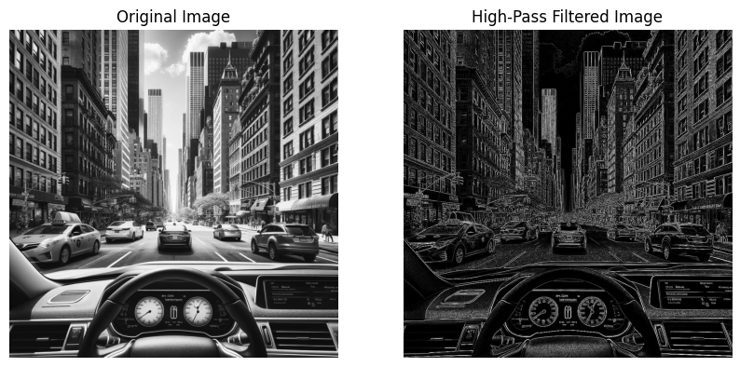
Low pass vs High pass filters
Low pass filters - allow low frequencies to pass through
Results in blurring and smoothing of the image
Useful in reducing noise and removing fine details
High pass filters - block low frequencies and allow high frequencies to pass through
Useful for detecting edges in an image, sharpening or enhancing details

Slide 10
What Can CNNs Do?
Image Classification
Object Detection
Neural Style Transfer
Face Recognition
Image Synthesis

Slide 11
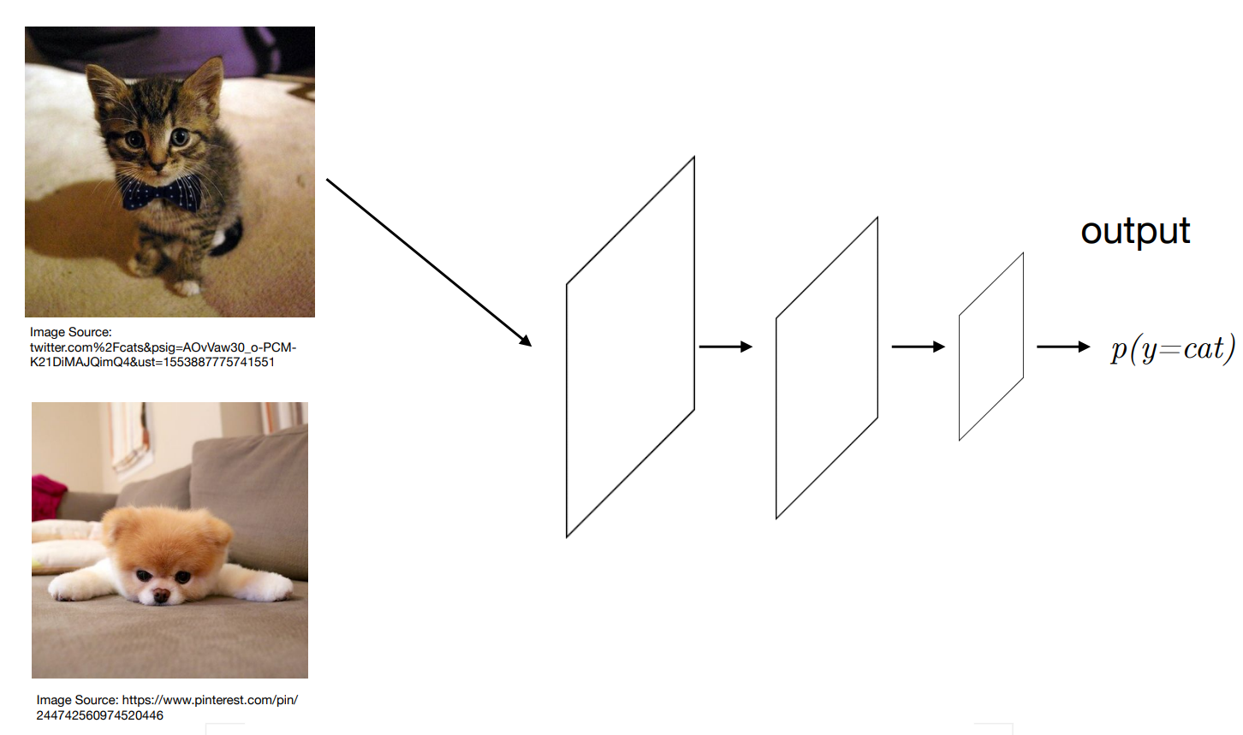
Image Classification

Slide 12
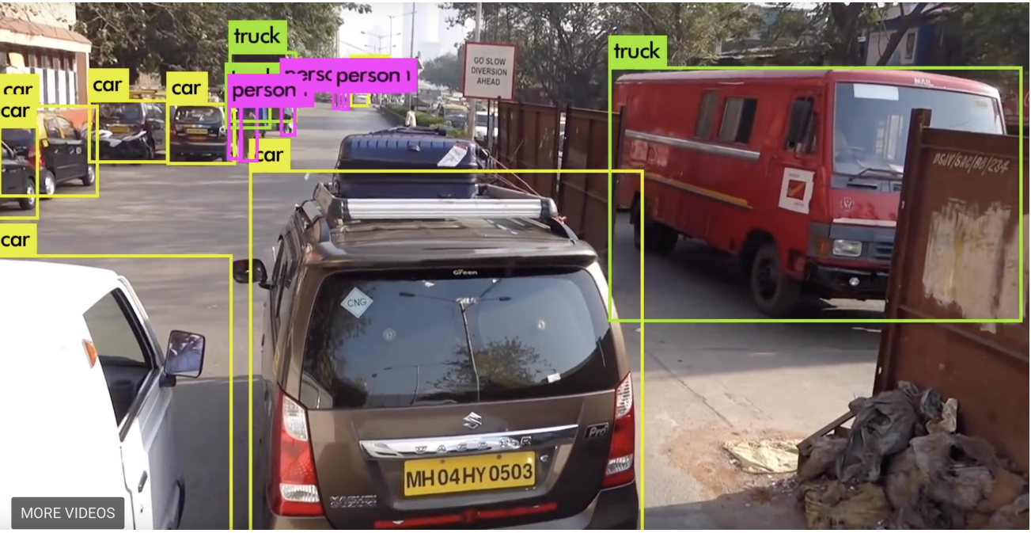
Object Detection

Slide 13
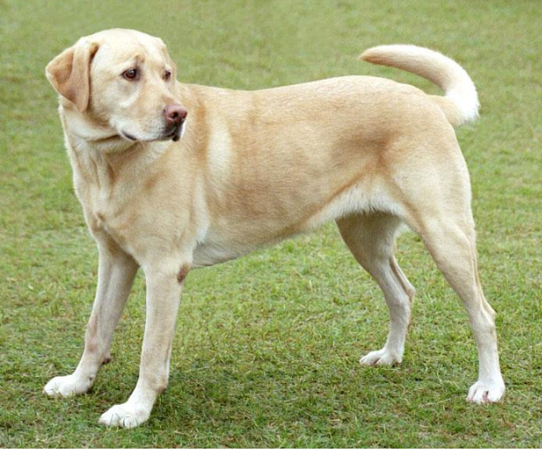
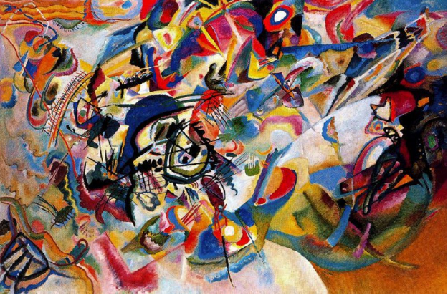
Neural Style Transfer

Slide 14
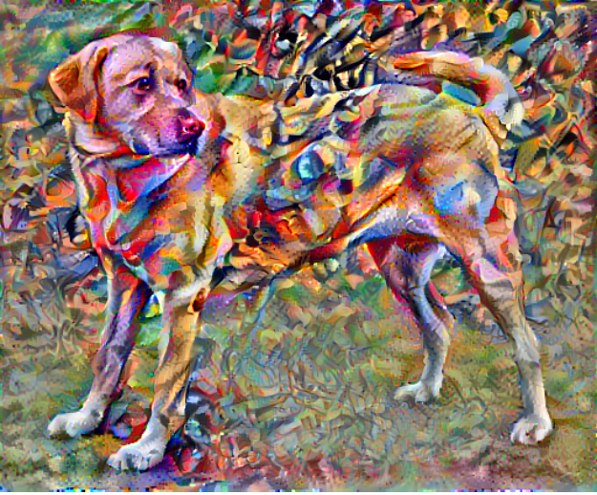
Neural Style Transfer

Slide 15
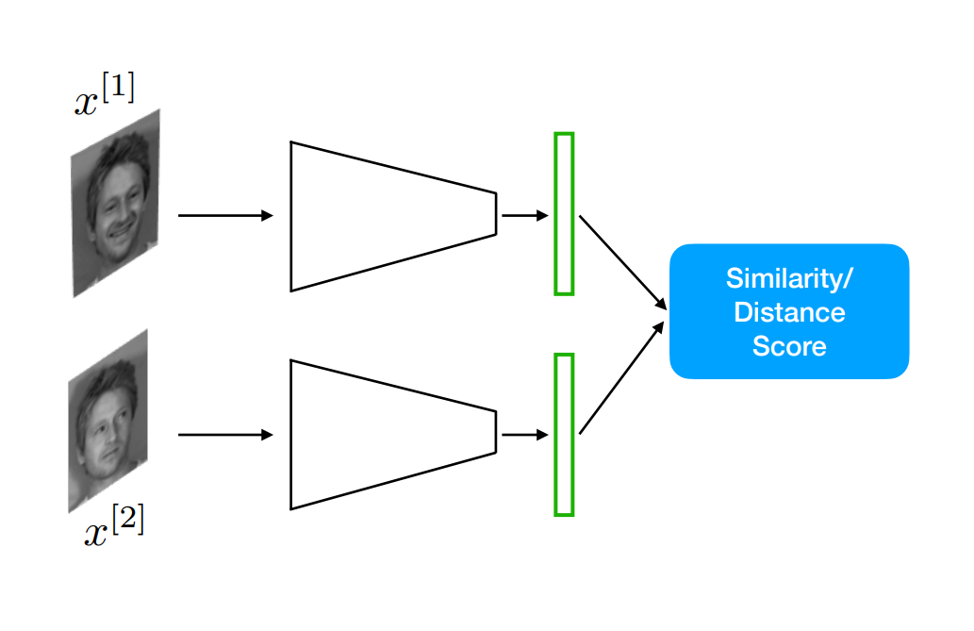
Face Recognition

Slide 16
Why CNNs?

Slide 17
Number of Parameters
1000x1000 pixel image with three channels then we would have 3 million input features.
If the first layer has 1000 neurons the neural net with just one layer would have approximately 3 billion parameters.

Slide 18
CNN Basics

Slide 19
CNN Principles
Translation invariance - Our network should respond similarly to the same patch, regardless of where it appears in the image.
Locality principle - Our network should focus on local regions, without regard for the contents of the image in distant regions.

Slide 20
WbWhat Is a CNN?
The convolutional neural network (CNN) is a specialized feedforward neural network designed to process multi-dimensional data, e.g., images
A CNN is a special case of neural networks which uses convolution instead of full matrix multiplication in the hidden layers
A CNN architecture is typically comprised of convolutional layers, pooling (subsampling) layers, and fully-connected layers (LeNet-5)

Slide 21
What is a Convolution?
In each convolutional layer of a CNN, a convolutional operation is performed along with the input of predefined width and strides. Each of these convolutional operations is called a "kernel" or a "filter"
An activation function is applied after each convolution to produce the output

Slide 22
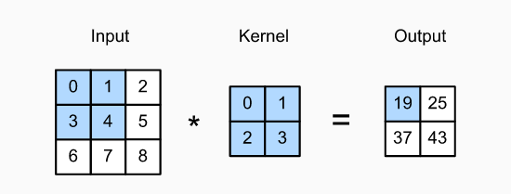
Convolution Operation
A single unit of a convolutional layer is only connected to a small receptive field of its input, where the weights of its connections define a filter
The convolution operation is used to slide the filter across the input, producing activations at each receptive field

Slide 23
Convolution Operation
The shaded portions are the first output element and the input and kernel array elements used in its computation:
0×0+1×1+3×2+4×3=19

Slide 24
Parameters Defining Convolution
Convolutions are defined by two key parameters:
Size of the filters extracted from the inputs. These are typically 3×3 (most frequently used), or 5×5
Depth of the output feature map - The number of filters computed by the convolution

Slide 25
Main Concepts Behind Convolutional Neural Networks
Sparse-connectivity: A single element in the feature map is connected to only a small patch of pixels. (This is very different from connecting to the whole input image, in the case of multilayer perceptrons.)
Parameter-sharing: The same weights are used for different patches of the input image.
Many layers: Combining extracted local patterns to global patterns

Slide 26
Weight Sharing
A "feature detector" (filter, kernel) slides over the inputs to generate a feature map
Rationale: A feature detector that works well in one region may also work well in another region
A big reduction in parameters to fit
Multiple "feature detectors" (kernels) are used to create multiple feature maps

Slide 27
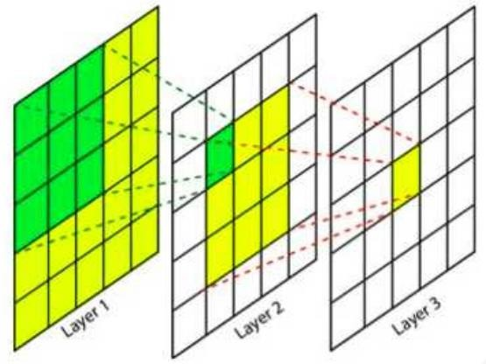
Receptive field in CNNs
This feature depends directly on 9 features of the previous layers, but indirectly on all the features of the initial layers, since each feature of the intermediate layer depends on 9 features of the previous layer. This means that a change in any of the features of the layer 1 will influence this features as well.
Image source: https://theaisummer.com/receptive-field/
Umar Jamil – https://github.com/hkproj/mistral-llm-notes

Slide 28
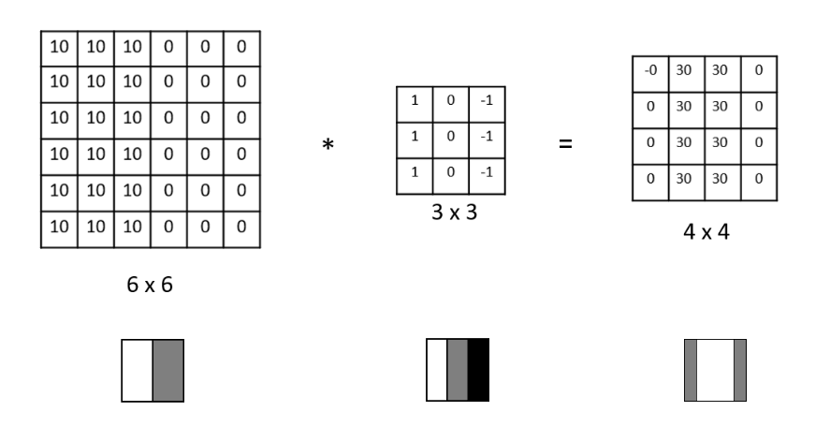
Edge Detection Example

Slide 29
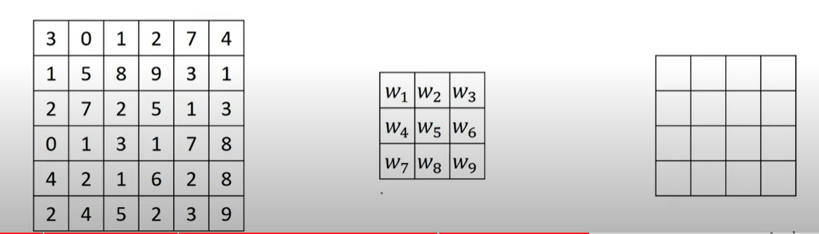
How Do We Choose the Weights of the Filters?
We use Gradient Descent and Backpropagation to find the optimal weights of the different filters.

Slide 30
Padding
Padding can increase the height and width of the output.
Padding works by adding an appropriate number of rows and columns on each side of the input feature map
This is often used to give the output the same height and width as the input to avoid undesirable shrinkage of the output
Padding ensures that all pixels are used equally frequently.
Typically we pick symmetric padding on both sides of the input height and width.

Slide 31
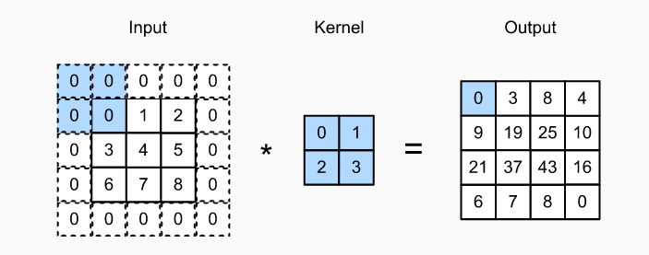
Padding

Slide 32
Padding in Pytorch
Some padding terminologies:
“constant” padding: pads the input tensor with a constant value
“reflect” padding: pads the input tensor using the reflection of the input boundary
“circular” padding: pads the input tensor using the reflection of the input boundary
“replicate” padding: uses the replication of the input boundary

Slide 33
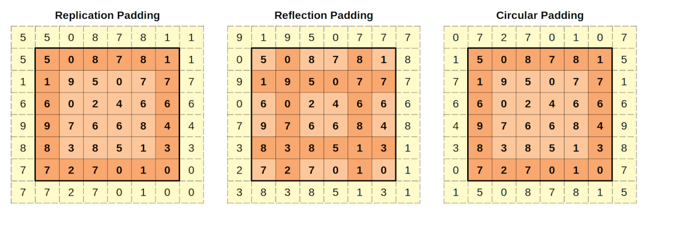
Padding in Pytorch

Slide 34
Stride
The distance between two successive windows is a parameter of the convolution, called its stride, which defaults to 1
It is possible to have strided convolutions: convolutions with a stride higher than 1.

Slide 35
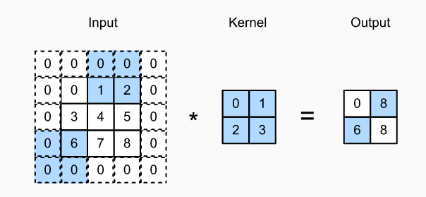
Horizontal Stride of 2 and
Vertical Stride of 3 Example

Slide 36
Pooling
Pooling is an exceedingly simple operation. It does exactly what its name indicates, aggregate results over a window of values
A big difference from convolution is that max-pooling is usually done with 2×2 windows and stride 2, to downsample the feature maps by a factor of 2
Pooling does not have any learnable parameters

Slide 37
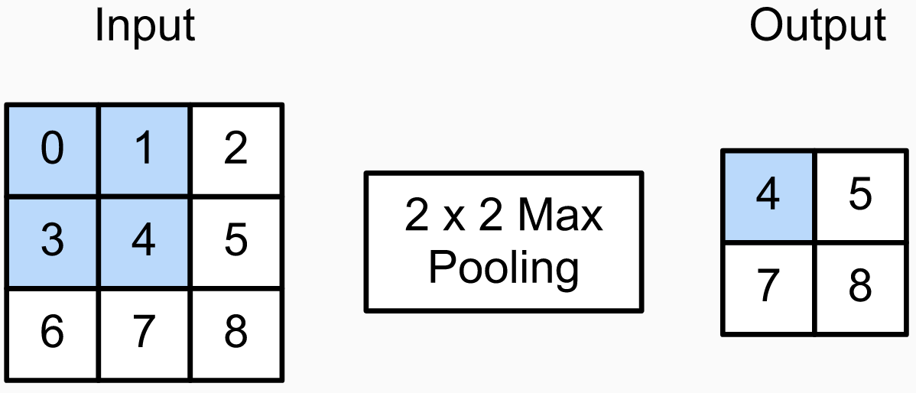
Pooling

Slide 38
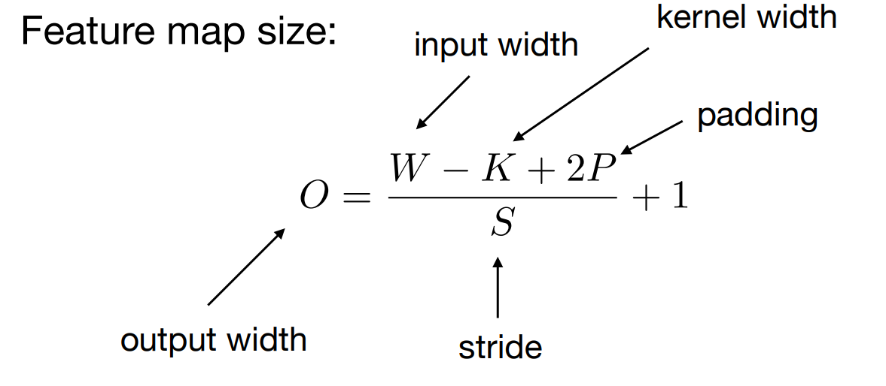
Size Before and After Convolutions

Slide 39
Convolutions with Color Channels

Slide 40
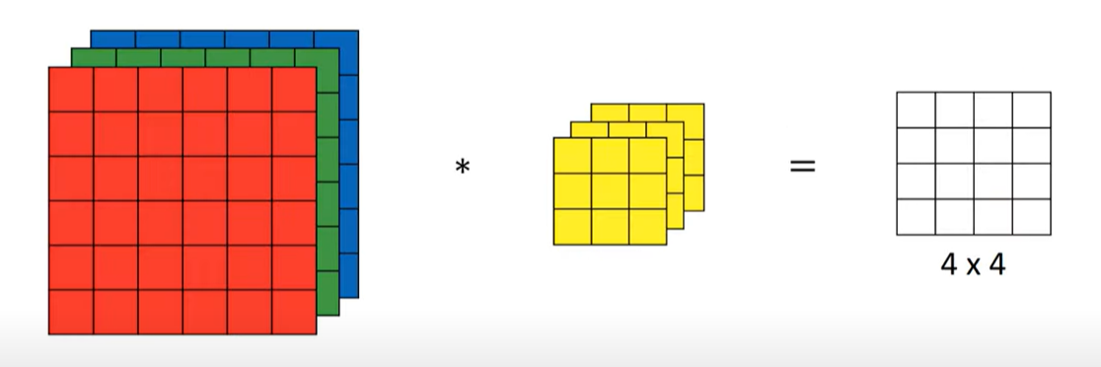
Convolutions with Color Channels
Convolving 6X6X3 with 3X3X3 gives you a 4X4 2D output

Slide 41
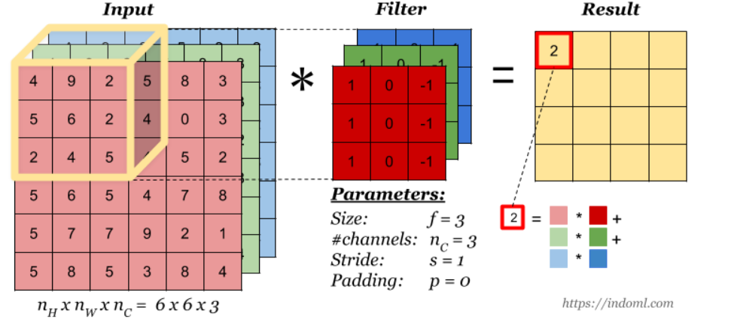
Convolutions with Color Channels

Slide 42
Convolution Operation with Multiple Filters
Multiple filters can be used in a convolution layer to detect multiple features.
The output of the layer then will have the same number of channels as the number of filters in the layer.

Slide 43
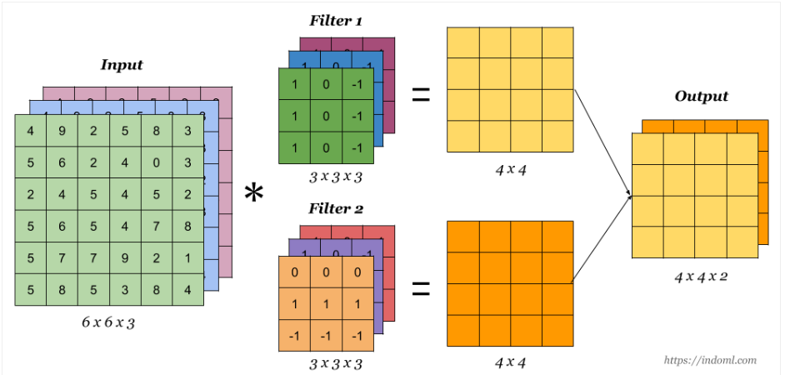
Convolution Operation with Multiple Filters

Slide 44
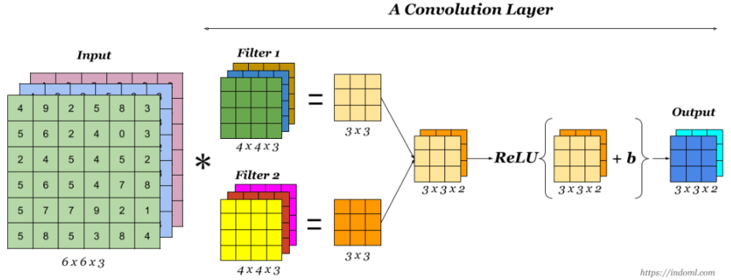
One Convolution Layer
Finally to make up a convolution layer, a bias is added and an activation function such as ReLU or tanh is applied.

Slide 45
One Convolution Layer Number of Parameters
If you have 10 filters 3x3x3 how many parameters do you have in this layer?
Does the number of parameters depend on the input size?

Slide 46
One Convolution Layer Number of Parameters
If you have 10 filters 3x3x3 how many parameters do you have in this layer?
Weights = 3*3*3 = 27
Bias = 1
Total parameters per filter = 28
Total Params for 10 Filters = 10 * 28 = 280 params

Slide 47
Data Augmentation

Slide 48
Data Augmentation
Image augmentation generates random images based on existing training data to improve the generalization ability of models.
In order to obtain definitive results during prediction, we usually only apply image augmentation to training examples, and do not use image augmentation with random operations during prediction.
Deep learning frameworks provide many different image augmentation methods, which can be applied simultaneously.

Slide 49
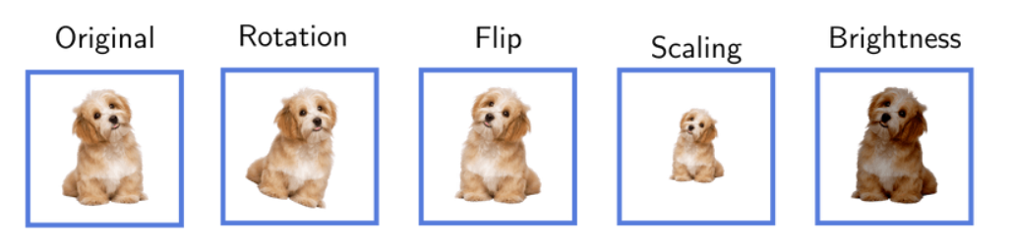
Data Augmentation

Slide 50
CNN Architectures

Slide 51
Le Net CNN Architecture
Handwritten digit recognition, developed by Yann Lecun in the 90s.
At a high level, LeNet (LeNet-5) consists of two parts: (i) a convolutional encoder consisting of two convolutional layers; and (ii) a dense block consisting of three fully connected layers;
The basic units in each convolutional block are a convolutional layer, a sigmoid activation function, and a subsequent average pooling operation.
Note that while ReLUs and max-pooling work better, these discoveries had not yet been made at the time.
Each convolutional layer uses a 5×5 kernel.

Slide 52
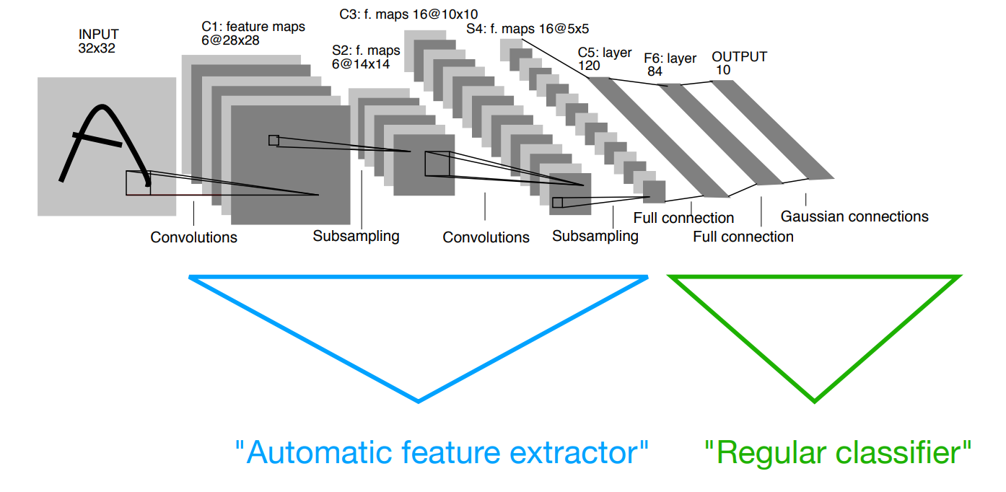
Hidden Layers

Slide 53
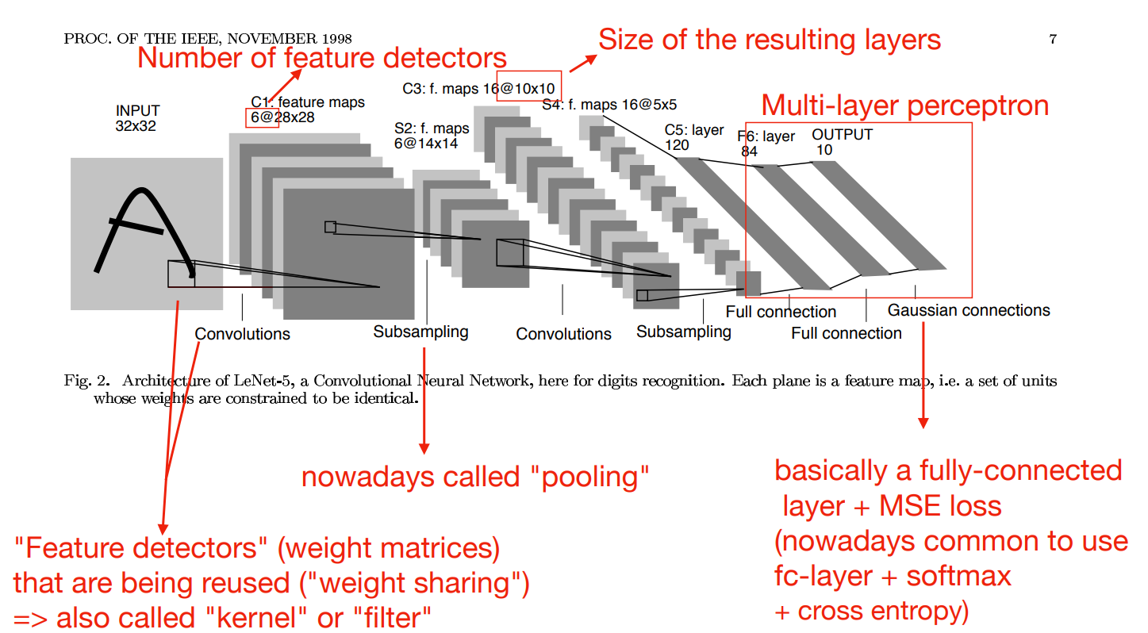
Le Net

Slide 54
AlexNet
Similar to LeNet but much bigger/deeper - around 60 million parameters
Invented by Alex Krizhevsky from Geoff Hinton's U of Toronto research group
Winner of the 2012 ImageNet.
Achieved 15.4% top-5 error rate. Next best 26.2% (Nowadays around 3%)

Slide 55
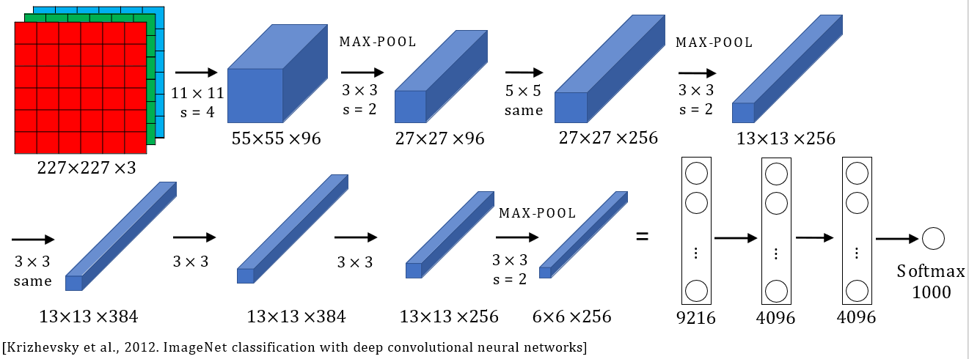
AlexNet

Slide 56
AlexNet Tricks
Multiple (small - 3GB) GPUs
Filters in the first conv layers much bigger than in the later layers
Uses ReLU instead of Sigmoid
Uses stride of 4 to reduce the dimensions in the first layers
Overlapping maxpool layers
One of the first to use Dropout
One of the first to use data augmentation

Slide 57
VGG
Developed by Visual Geometry Group at The University of Oxford in 2014
Similar to AlexNet but much bigger/deeper - 138m parameters
Along with GoogLeNet is the first to bring the top-5 error rate below 10%
There are several variants - VGG-11, VGG-13, VGG-16, VGG-19

Slide 58
VGG Tricks
Simplifies the architecture
Same filters (3x3, stride - 1, padding - same) for all layers
Same pooling (2x2, stride - 2)
Double the number of filters after every stack of conv layers
As you go deeper height and width go down and the number of channels goes up

Slide 59
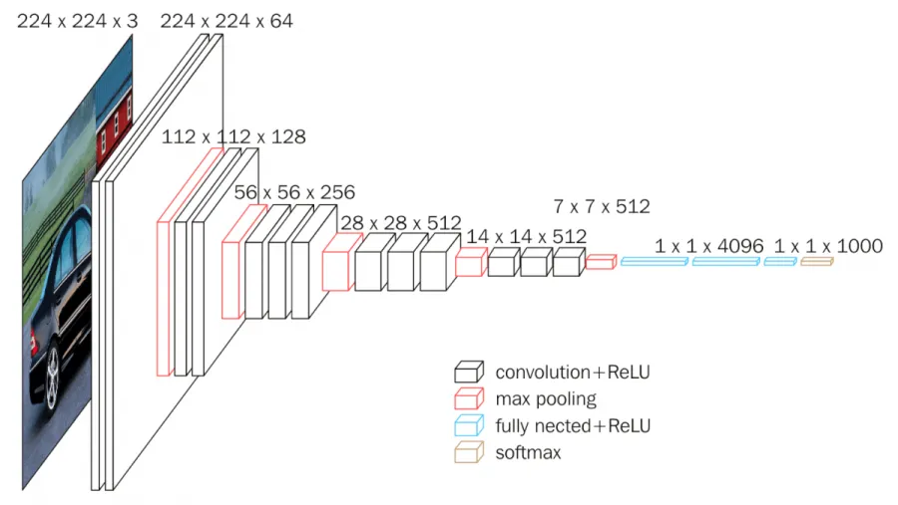
VGG 16

Slide 60
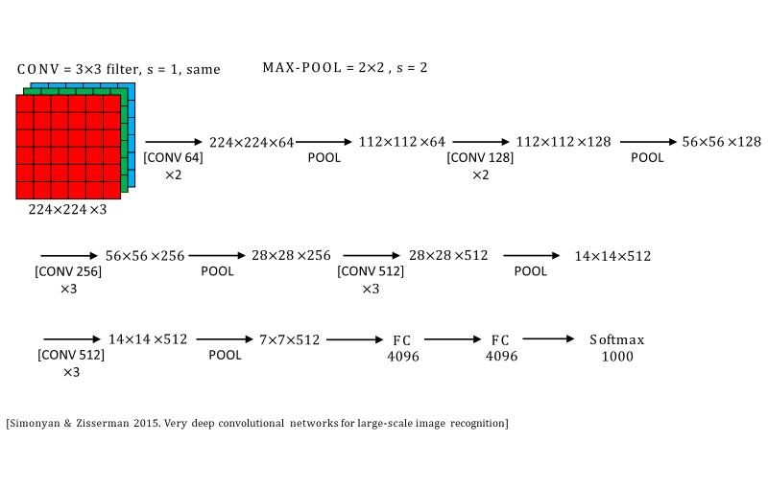
VGG 16

Slide 61
Residual Networks (ResNet)

Slide 62
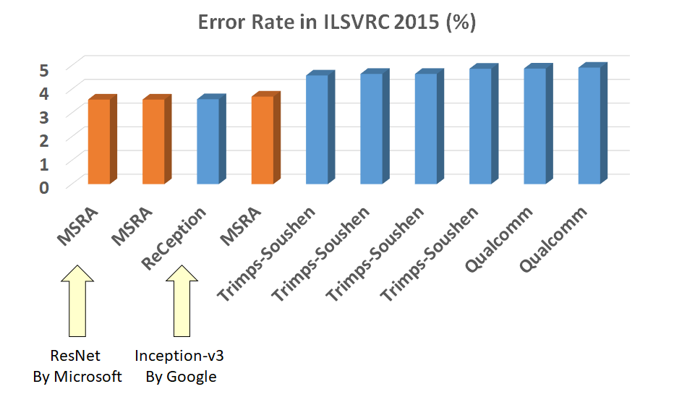
Residual Networks (ResNet)
Invented by Microsoft Research, winner of the ImageNet 2015 Very deep network consisting of residual blocks that improve the gradient flow and reduces the vanishing gradient

Slide 63
ResNet The Problem
The goal was to increase the depth of the CNNs
Deeper CNNs perform better, generalized better, achieve lower training loss BUT optimizing them is hard - vanishing gradient
This is not a problem of overfitting
The deeper you go into the network each layer would not learn much and thus it should be able to default to the identity function

Slide 64
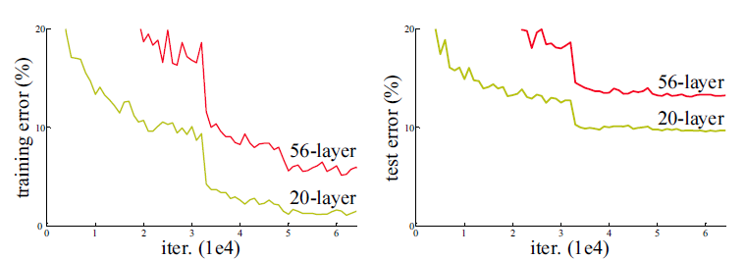
Plain network: Vanishing gradient
The deeper network has higher error rate not only during testing but even on training. This suggests that the training process is so hard it is unable to overfit although it has much bigger number of parameters.

Slide 65
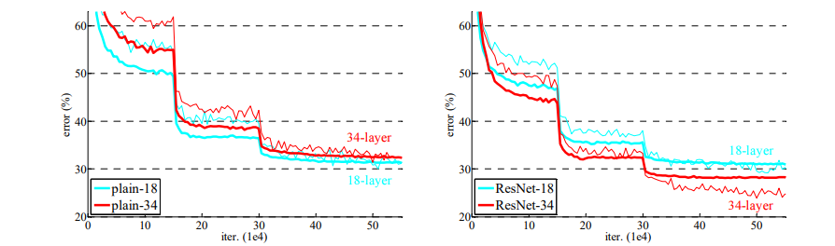
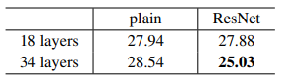
ResNets VS Plain network

Slide 66
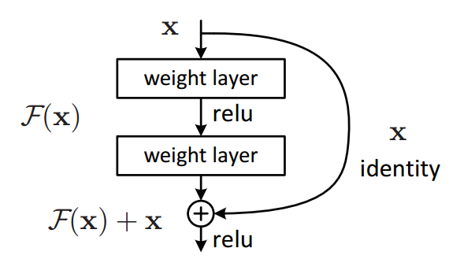
Residual Networks (ResNet)
Residual layer
The layer is called residual because it has to learn the residual mapping F(x)= H(x) - x

Slide 67
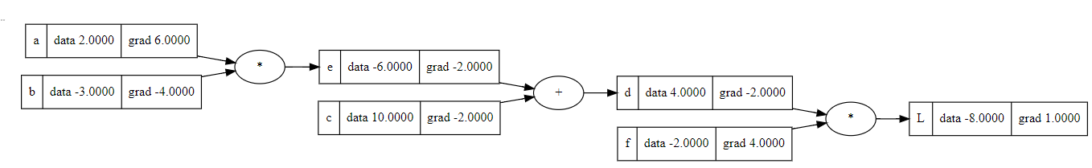
Residual Networks (ResNet Gradient) Gr
Derivative of summation is very easy to calculate - it distributes the derivative to all child nodes.
Y = F(X) + X
Local -> dY/dX = 1 using the chain rule -> dL/dX = 1 * dL/dY
Local -> dY/dF(X) = 1 using the chain rule -> dL/dF(X) = 1 * dL/dY

Slide 68
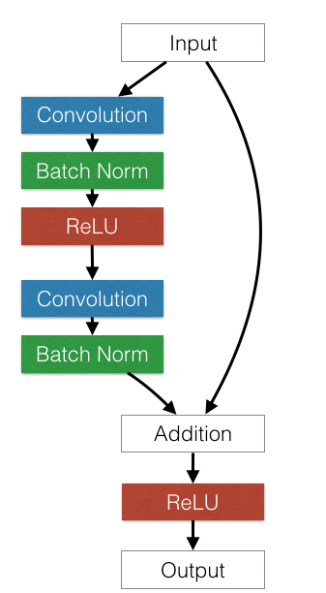
Residual Layer
This path is very useful for backpropagation
Provides immediate feedback,
skips 2 Conv and 2 BatchNorm layers
It is usually called skip or shortcut connection
The dimensions of the input and the output of the second BatchNorm have to match

Slide 69
Residual Layer
The Conv-BatchNorm-ReLU block is fundamental for many networks
This path is very useful for backpropagation
Provides immediate feedback,
skips 2 Conv and 2 BatchNorm layers
It is usually called skip or shortcut connection

Slide 70
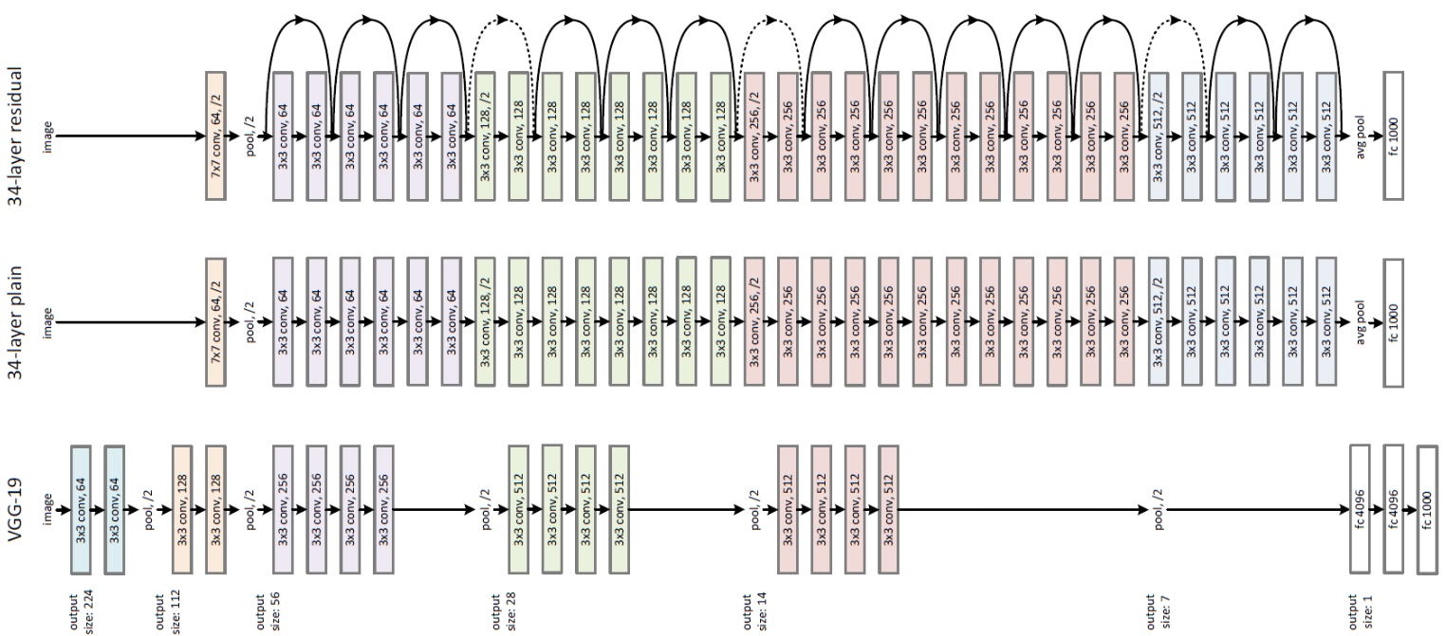
Residual Network: Example and Comparison
Residual block
Empirically shown easier to train a 34-layer deep residual net than a plain
network

Slide 71
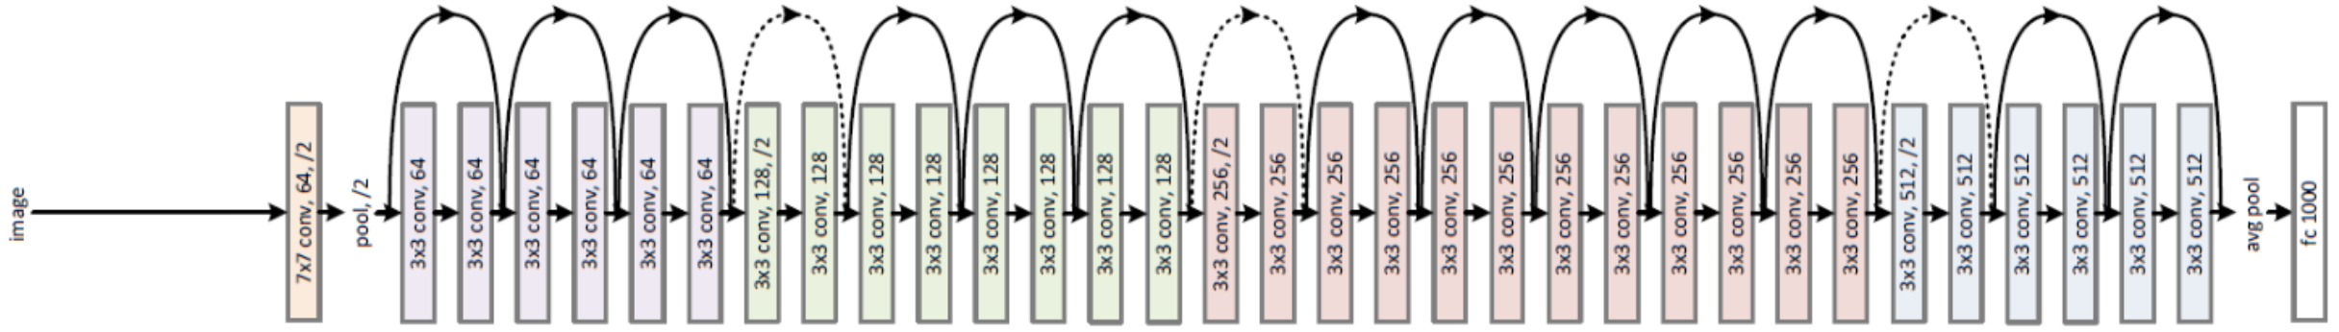
ResNet: Downsampling
ResNet downsamples the input spatial dimensions 32 times using pooling or conv with stride 2

Slide 72
ResNet: Downsampling
ResNet downsamples the input spatial dimensions 32 times using pooling or conv with stride 2 To add a skip connection after dimensionality change use 1-1 convolutions

Slide 73
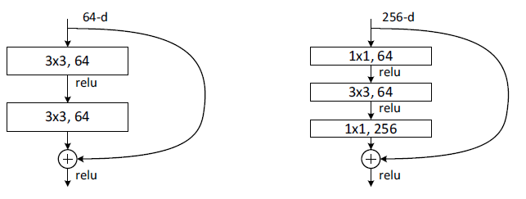
Residual Layer
Basic
Basic with bottleneck
ResNet uses a bottleneck to avoid parameter explosion With bottleneck, a 34-layer deep ResNet becomes a 50-layer ResNet
Notes:
- bottleneck
- 34 becomes 50

Slide 74
Transfer Learning

Slide 75
Transfer Learning
“You need a lot of data if you want to train CNN / Deep Neural Network”

Slide 76

Transfer Learning
“You need a lot of data if you want to train CNN / Deep Neural Network”

Slide 77
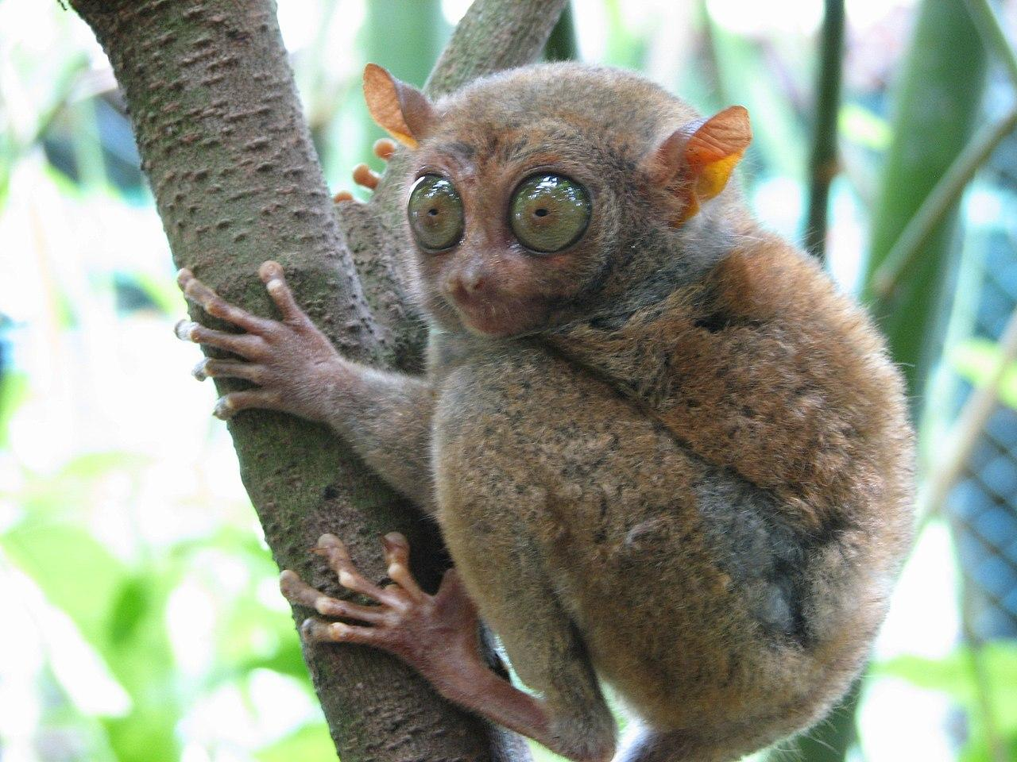
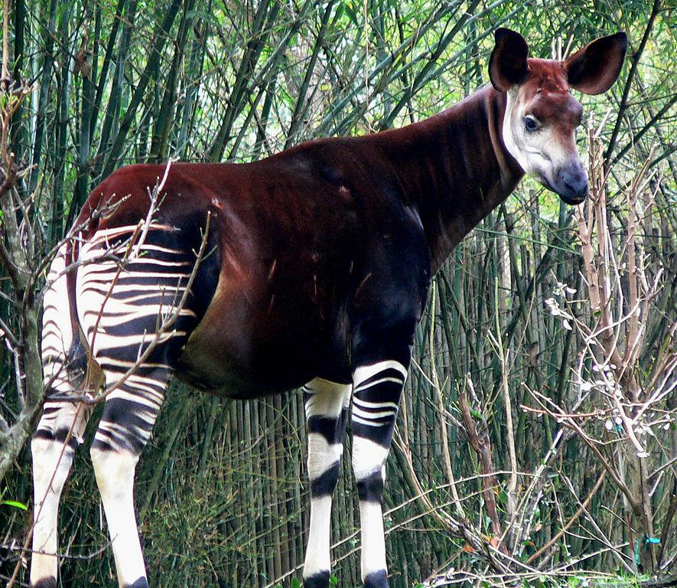




How to build a [Rare animals classifier]
6 new animal classes
50 examples per class
very hard to obtain new examples (hard to photograph)

Slide 78

Transfer Learning
1. Train on ImageNet

Slide 79

Transfer Learning
1. Train on ImageNet
2. Small dataset (C classes)

Slide 80

Transfer Learning
1. Train on ImageNet
2. Small dataset (C classes)
3. Bigger dataset

Slide 81


Vision Transformer (ViT): An Image is Worth 16x16 words
Naive application of self-attention would require each pixel to attend on every other. This does not scale!
Solution: Break down image in patches.
The Transformer’s sequence length is inversely proportional to the square of the patch size.
Smaller patches -> slower.

Slide 82

CLIP: Contrastive Language-Image Pretraining
Trained on 400 million (image, text) pairs
Predicting the exact words for the text is difficult
Pre-training task is to determine which caption goes with which image

Slide 83

CLIP: Contrastive Language-Image Pretraining

Slide 84

CLIP: Contrastive Language-Image Pretraining

Slide 85
References
First Principles of Computer Vision (Shree Nayar)
Convolutional Neural Networks (Course 4 of the Deep Learning Specialization)
CS231n: Deep Learning for Computer Vision - Stanford University
Introduction to Deep Learning by Sebastian Raschka
Dive into Deep Learning - Zhang, Lipton, Li

